Slide 1

Secured-T
Team Members:
Radin Ayuwandira Binte Radin Amirmuminin (Leader) P1444968
Lim Xin Li (Assistant Leader) P1529546
Bavani D/o Raman P1551271
T. Puvarneswaren Raja P1551354
Supervisor:
Mr Karl Kwan, SP-DMIT
© 2017 Singapore Polytechnic (DISM/FT/3A/01/62)

Slide 2
Presentation Outline
Background
Objectives
Milestones
Solution and how it works
Shortcomings and countermeasures
Conclusion
© 2017 Singapore Polytechnic (DISM/FT/3A/01/62)

Slide 3
Background
In most educational institutions, examinations are conducted as written papers each year. However, for technical related modules that involves programming, it requires students to do coding. Students are not able to make use of the available online resources and would have to rely on their memory.
In a normal examination room, several invigilators are needed to prevent students from cheating. Having the secured system allows for lesser invigilators as the students’ activities can be monitored on one screen.
© 2017 Singapore Polytechnic (DISM/FT/3A/01/62)

Slide 4
Objectives
To attain a secured system for:
Lecturers to facilitate online examinations and prevent cheating amongst students.
Students to be able to use their own notebook to access the available resources and take the online examinations.
© 2017 Singapore Polytechnic (DISM/FT/3A/01/62)

Slide 5
Milestones
Week 1 - 4
Week 5
Week 5 - 12
Initiation and Plan
Research
System Programming
Interim Presentation
Execution
Research
Design
Web Application and System Programming
Integration
© 2017 Singapore Polytechnic (DISM/FT/3A/01/62)

Slide 6
Milestones
Week 13 - 16
Week 17 - 18
Week 18
Configuration
Implementation
Web Application and System Programming
System Testing and Preparation
Debugging
Preparation for release
Final Presentation and Release of Deliverables
© 2017 Singapore Polytechnic (DISM/FT/3A/01/62)

Slide 7
Solution: Secured-T
© 2017 Singapore Polytechnic (DISM/FT/3A/01/62)

Slide 8
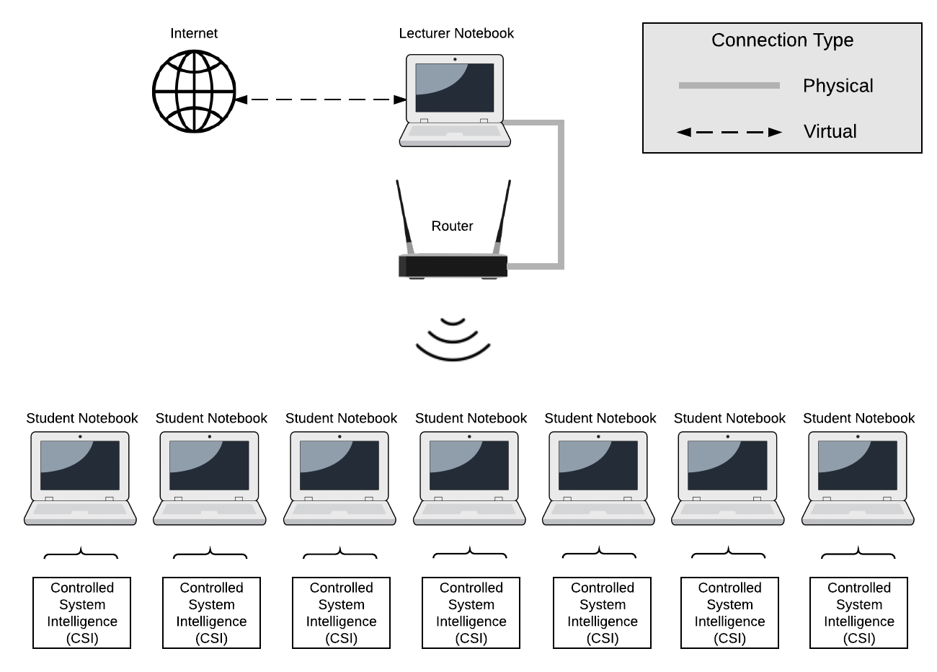
How Secured-T Works
© 2017 Singapore Polytechnic (DISM/FT/3A/01/62)

Slide 9
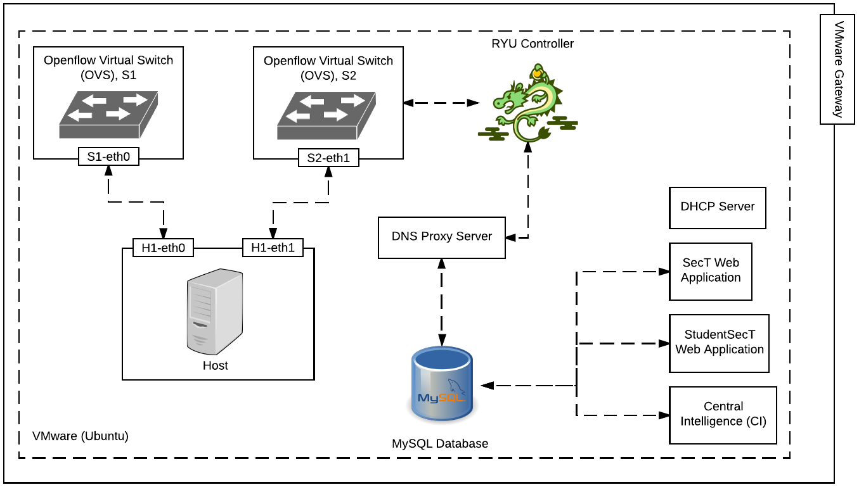
Inside Lecturer’s Notebook
© 2017 Singapore Polytechnic (DISM/FT/3A/01/62)

Slide 10
© 2017 Singapore Polytechnic (DISM/FT/3A/01/62)
Notes:
While the students’ notebooks are wirelessly connected to the router, they will have to download the Controlled System Intelligence Program into their notebooks and run the program. What this program does is that

Slide 11

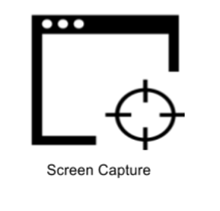
Heartbeat
Pulsates status every eight seconds
Status includes OK or CHEAT
Keylogging
Automatically record keys pressed when students cheat
Record keys pressed when it is demanded by invigilator
Screen Capture
Automatically take screenshot of students’ screens when they cheat
Take screenshot of student’s screen when demanded by the invigilator
© 2017 Singapore Polytechnic (DISM/FT/3A/01/62)
Notes:
It works like a heartbeat where it pulsates either OK or CHEAT every eight seconds.
It also provides keylogging and screen capture where it is automatically started when students cheat and it can be demanded by the invigilators as well.

Slide 12
Shortcomings and Countermeasures
© 2017 Singapore Polytechnic (DISM/FT/3A/01/62)

Slide 13
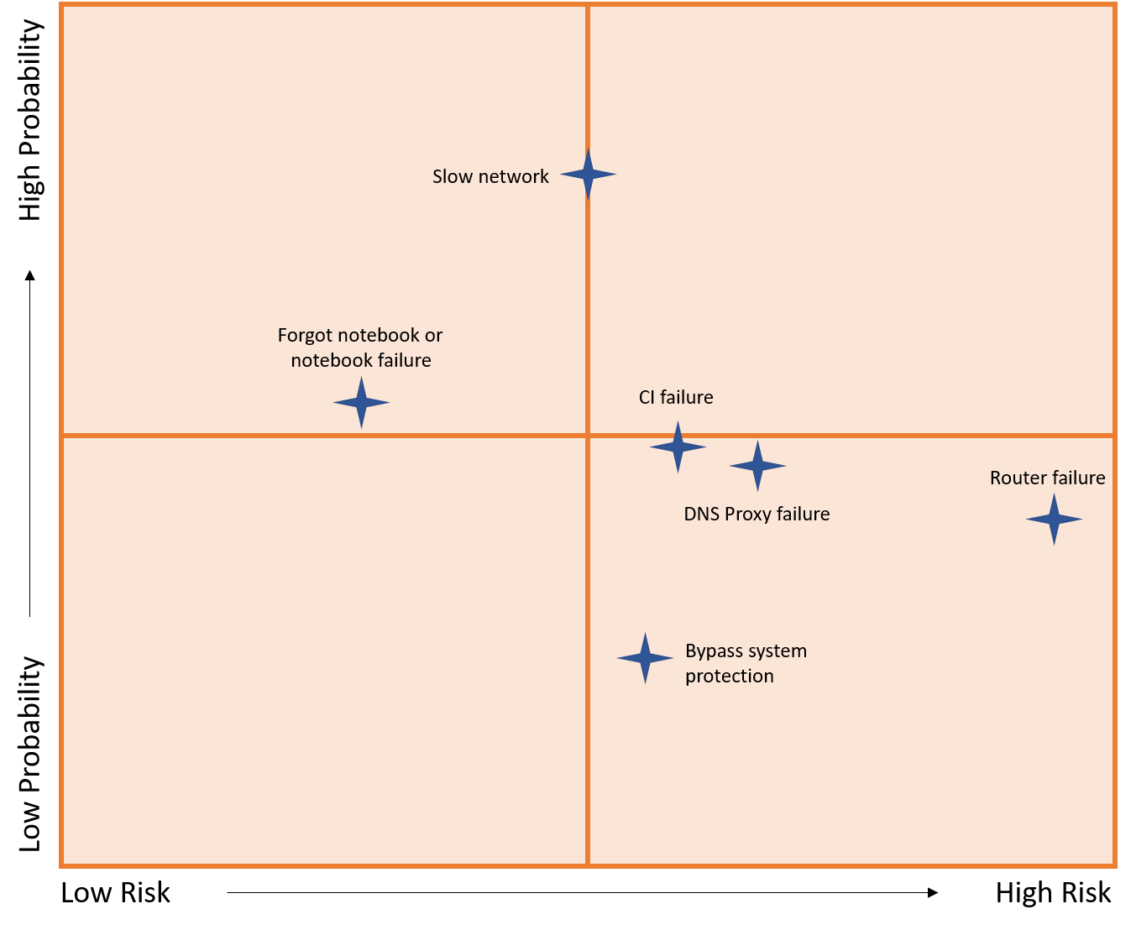
Shortcomings
© 2017 Singapore Polytechnic (DISM/FT/3A/01/62)
Notes:
We have come up with some of the common shortcomings of our system that could affect the accuracy of an examination.
Forgot notebook or notebook failure – Huge windows update, overheating problem
Slow network – Huge number of students connect, cause it to slowdown and there is a possibility of unstable connection if there is a stronger network
CI failure, DNS Proxy failure, router failure – Program errors, router got damaged
Bypass system protection – another network card

Slide 14
Countermeasures
Shortcomings | Countermeasures
Router Failure | Have backup routers
Forgot notebook or notebook failure | Send reminder by message, iChat or both
 | Have extra notebooks that can be lent to the students
 | Do notebook testing before the assessment
DNS and CI Failure | Invigilators should make sure the blacklisted websites are blocked and the monitoring page works correctly a few hours before the assessment
Bypass System Protection | Invigilators should be walking around the room to ensure that the websites accessed are allowed
Slow Network | Implement more than one router
© 2017 Singapore Polytechnic (DISM/FT/3A/01/62)

Slide 15
Conclusion
© 2017 Singapore Polytechnic (DISM/FT/3A/01/62)

Slide 16
Outcome
Initial Goals:
Allow students to use the available online resources during examination
◻ Prevent students from cheating
◻ Allow lecturers to monitor students’ connection status
◻ Allow lecturers to log students’ activities
◻ Allow lecturers to limit access to domains
Achieved Goals:
Lecturers can monitor students’ connection status
Heartbeat
☑ Lecturers can log students’ activities
☑ Screen capture
☑ Keylogger
Lecturers can allow whitelist domains
Students can use the available online resources allowed by the lecturer
Students can upload submissions
☑ Open source
© 2017 Singapore Polytechnic (DISM/FT/3A/01/62)

Slide 17
Thank You
© 2017 Singapore Polytechnic (DISM/FT/3A/01/62)
Notes:
To know more about our project, feel free to come and visit us at our booth!

